Slide 1
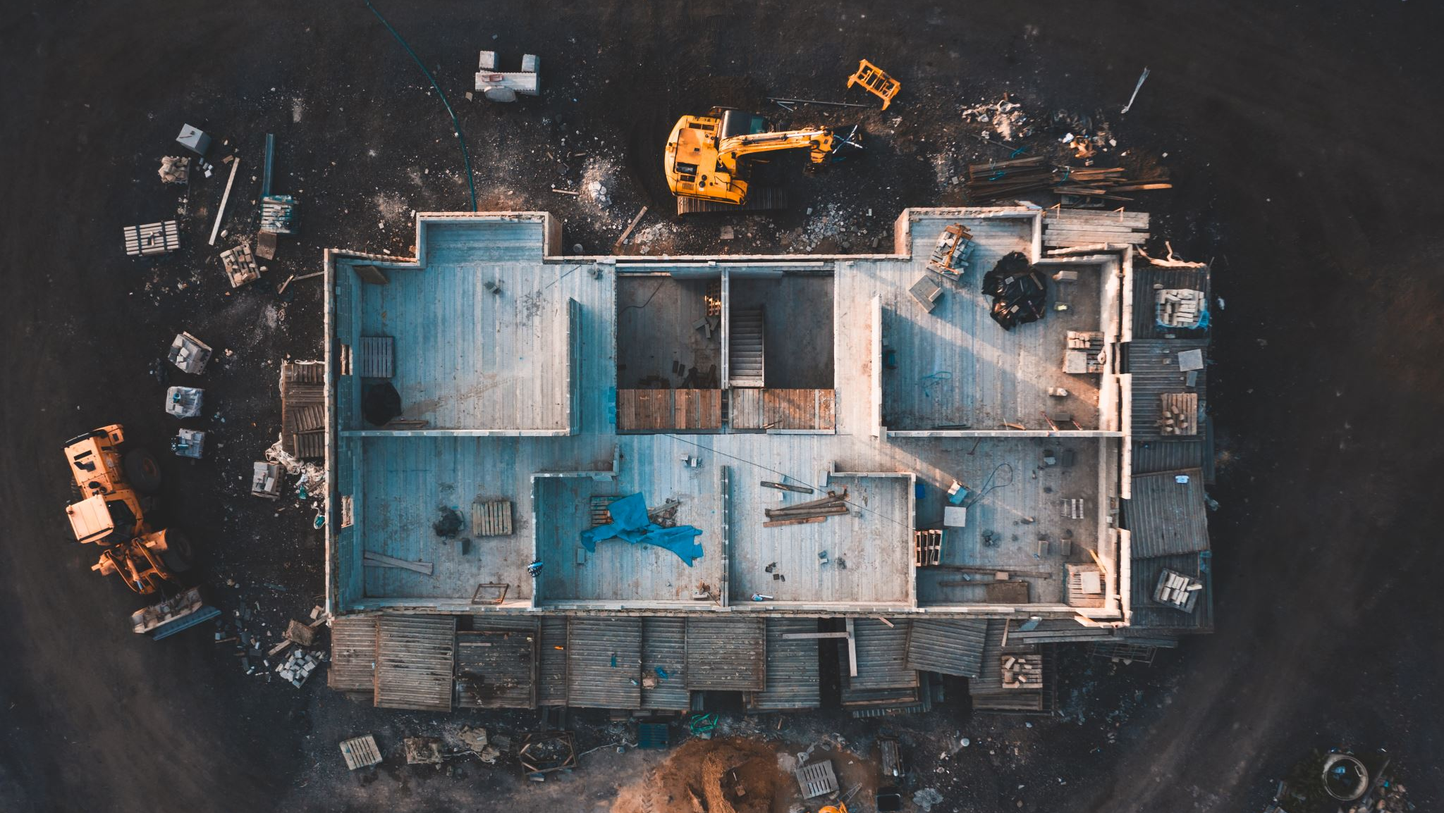
Ames Iowa Housing
Regression Analysis and Data visualization
Springboard.com

Slide 2
--->
Identify the variables that help to determine the Ames Iowa sales price.
Break down the way the price was structured to determine the influential variables.

Slide 3
Problem Statement Worksheet (Hypothesis Formation)
There are some of the variables that included in a multiple regression will help us to determine the sale price over the houses in Ames Iowa.
H
1
Context
4
Constraints within solution space
We have some data from 1870 to 2009. The data include 2190 rows or houses in Ames Iowa with different details about them. Sale price is the dependable variable and our focus that will help us to determine how it will get affected in relation to the other variables.
We do not know for sure if any of these models will have a good correlation or what is the right combination to determine this model.
2
Criteria for success
5
Stakeholders to provide key insight
A treemap and multiple regression models will help to understand how the price is built.
Zach
3
Scope of solution space
6
Key data sources
Sales is the main point of focus, as well as overall qualification an Square Footage.
Ames Iowa Housing.cvs

Slide 4
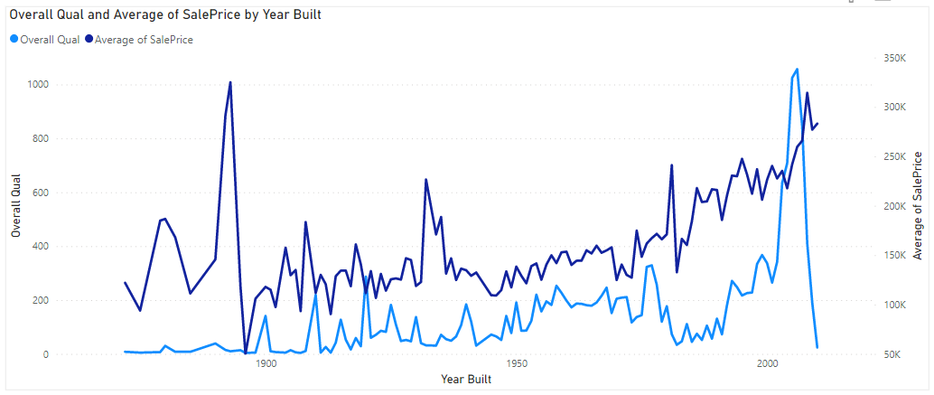
<Setup> There’s an initial correlation that shows the influence of the overall quality over the sale price.

Slide 5
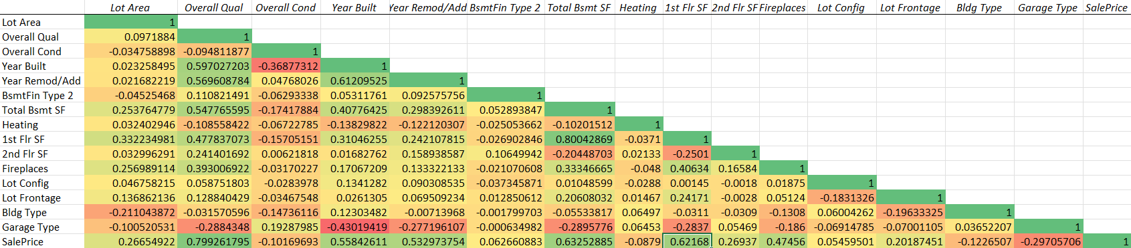
<Saleprice correlation> We can see in this correlation vs SalePrice an initial set of variables that affect positively and negatively the house’s sale price in Iowa.

Slide 6
<Multiple Regression Model> Overall Quality regression
There’s a good correlation between the variables chosen and Overall qualification.
1st Floor SF regression (2.52)is by far the variable that affects positively the Overall Quality.
Kitchen above the ground could affect negatively the house qualification by (1.04)/overall quality digit.
Building type, full bath, garage cars and fireplace could help to improve the overall quality by (0.65)

Slide 7
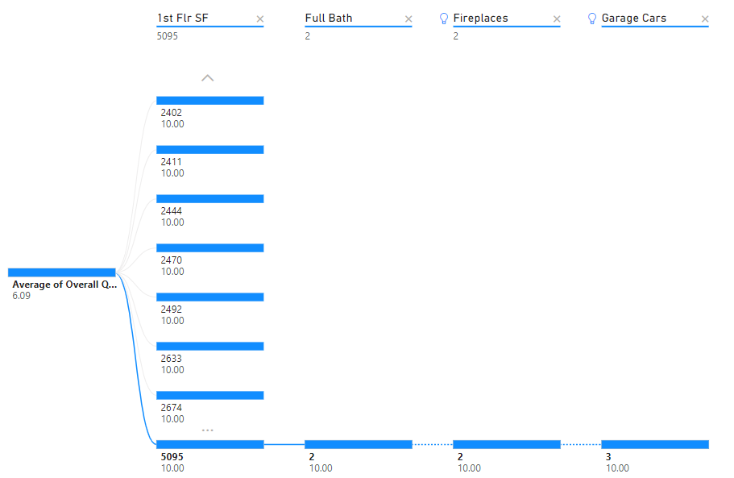
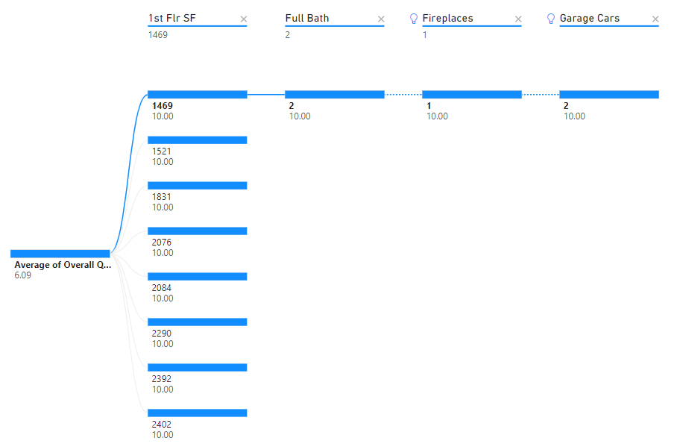

Overall Quality Breakdown Possible scenario based on the variables that influence the overall qualification in the regression model.
Highest 1st Floor Square Feet house configuration based on the most influential variables of the regression model.
Lowest and middle 1st Floor SF houses configuration based on the most influential variables of the regression model.
Important: Overall Quality 6 is taken as a reference because is the number whit the highest qualification overall houses.

Slide 8
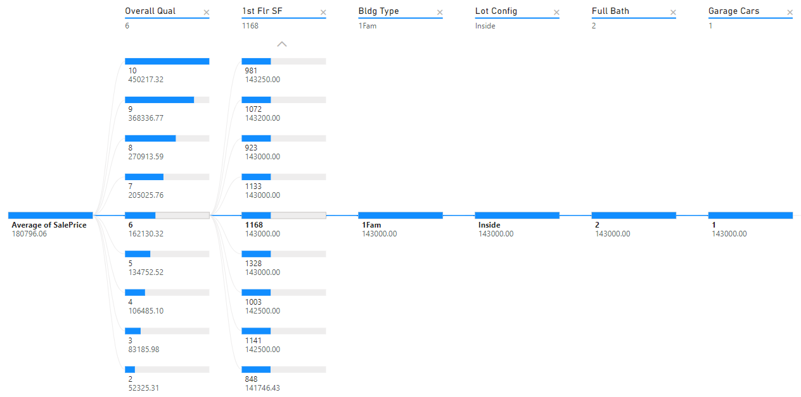

<House Configuration> Overall Quality 6 vs Overall Quality 2,4,8 and 10.

Slide 9
Resolution
Sale Price gets affected positively by the overall quality.
Every increase in the overall quality also represents an increase in the 1st Floor SF variable by (2.52).
Houses with Square feet between 1489 and 1861 has an average of 2 Full Bathrooms, 1 Fireplace and 2 Garages.
Houses from 2076 SF and higher: 2 Full Bathroom, 1 Fireplace and 3 Garages.

Slide 10
Average Sale Price in Ames Iowa Housing:
AVG Sale Price: $180.796
Overall Quality: 6 (Taken as a reference)
1st Floor SF: 1168
Building type:1Family
Lot Config: Inside Lot
2 Full Bathroom
1 Fireplace
2 Garages

